Slide 1
Data Management in Mobile Peer-to-Peer Networks
Bo Xu and Ouri Wolfson
University of Illinois at Chicago
Presentation by: Ashwin Kumar Kayyoor

Slide 2
Outline
Introduction
Challenges
3 Layered Architecture
Discuss each layer
Relevant work
Conclusion

Slide 3






I Have Two Free Tickets

Slide 4

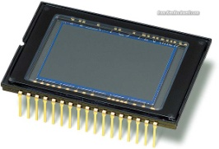

Introduction
Mobile p2p network is a set of moving objects that communicate via short range wireless technologies.

Slide 5
Challenges
Dynamic, unpredictable and partitionable network topology
Limited p2p communication throughput
Need for incentive for both information supplier and propagators

Slide 6
Architecture
Relevance
Evaluation
Query
Language
Economic Model
Usage
Strategies
Utility
Layer
Data Dissemination
Query Processing
Transaction Management
Support
Layer
Spatio-temporal Resource Data Model
Data
Layer

Slide 7
Data Layer
Resource model:
  Taxi-cab requests – Resource type
  Cab request – Resource
  Location of the customer - Resource home
  Time period since the request is issued, until the request is satisfied or cancelled – Valid duration

Slide 8



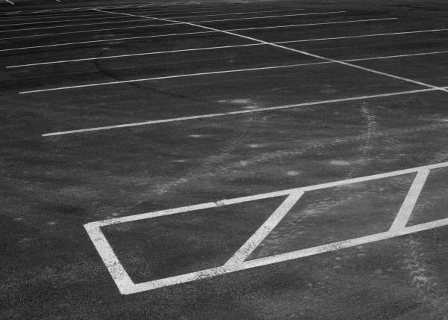
Data Layer (cont..)
Peers and Validity Reports
  Each peer that senses the validity of resources produces validity reports
  Validity Report
resource-id: SensorPLot
create-time: 09/22/0
home-location: plot 5
Broker
Consumer

Slide 9
Data Layer (cont..)
There are two relations in the reports database of a peer:
  Consumer relation
  Broker relation
Schema
Resource-type
Resource-id
Report-description

Slide 10
Data Layer (cont..)
Report Relevance:
  Priority to important reports
  Rank all the reports in a peer’s reports database in terms of their expected utility
  Relevance: Expected utility of a report to a peer at a particular time and particular location.

Slide 11


Support Layer:
Data Dissemination:
> min(Relevance (m1))
m1
m2
Resource report | Relevance
D2 | 0.7
D5 | 0.65
D1 | 0.5
D9 | 0.45
D3 | 0.3
Resource report | Relevance
D6 | 0.5
D2 | 0.46
D3 | 0.43
D9 | 0.35
D8 | 0.26

Slide 12
Support Layer (cont..)
The Economy Model:
  Idea is to motivate peers to participate in report dissemination by providing incentive.
  Virtual Currency and the Security Module
  Producer-paid Reports
  Consumer-paid Reports

Slide 13
Utility Layer
Query and Query Processing:
  Each peer m maintains a local reports DB.
  Collection of the local DBs of all the peers form virtual DB.
  Problem is to query these virtual DBs.
  Example: A driver wants to know all the parking slots located inside downtown area and who relevance is higher than 0.5

Slide 14
Utility Layer
Query Template:
SELECT select-list [FROM reports] WHERE where-clause
[GROUP BY gb-list [HAVING having-list]]
[EPOCH DURATION epoch [FOR time]]
[REMOTE query-destination-region [BUDGET]]

Slide 15
Utility Layer
Query Template:
Reports represents virtual DB.
EPOCH DURATION clause specifies the query life time.
REMOTE clause specifies whether query is to be answered by the local DB or to be evaluated in a remote geographic region.
BUDGET: How much budget in virtual currency the user is willing to spend for disseminating query and collecting answers

Slide 16
Utility Layer
Query Language:
Example: Query to notify a route #8 buses to wait if the bus arrives at P between 10:08 and 10:10
SELECT resource_id
FROM reports
WHERE resource-type=BUS and
report-description.route_no=8 and
WITHIN_DISTANCE_SOMETIME_BETWEEN(report-description.Traj, P, 0,10:08, 10:10)

Slide 17
Utility Layer
Remote Query Processing:
  Remote query from moving object m is processed in 3 steps:
  Trajectory of the querying moving body is attached to the query so that answering objects know where to return answers.
  The query is disseminated from m to the moving objects in the query-destination region.
  Answers are returned to m.

Slide 18
Utility Layer
Query Dissemination:
  Flooding increases communication cost.
  Objective: optimal tradeoff between communication cost and accuracy of answers.
  Should depend on: location, moving direction of m2 relative to the query-destination-region, the density of moving objects, and the budget of the query.

Slide 19





Utility Layer
Answer Delivery:
  Possible strategies to propagate the answer back to the query originator m:
Consolidates results
q
r
m

Slide 20
Utility Layer
Answer Delivery:
Leader: consolidates results
q
r
m

Slide 21




Leader
Answer Delivery:
Leader
Leader: consolidates results
Leader
Leader:
consolidates
results
m
q
r

Slide 22
Utility Layer
Transactional Issues:
  Example: Credit of one account should be committed only if the debit of the other account is committed.
  In turn this should occur if and only if corresponding report was received properly.

Slide 23





Utility Layer
Transactional Issues:
  Solution: Mobile P2P Transaction (MOPT).
  Online component of MOPT temporarily credits and debits the unsuccessful transactions (also logs it).
5$
- 5$
5$
+5$

Slide 24
Utility Layer
Transactional Issues:
  The offline component of MOPT: sends logs to the central bank and settles the credit/charge of the accounts.
5$
5$

Slide 25
Thanks!

